Slide 1
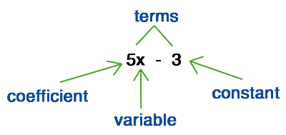
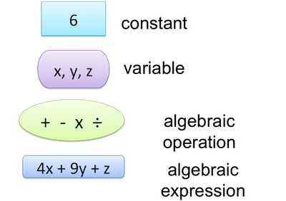
My Algebra Interactive Notebook
Name
Class
Teacher Mr Evans
Term 2 Semester 1
1

Slide 2
Contents
Glossary or Formula Page
Page
Date
Description
2
3

Slide 3
Tasks
24
7
30
Essential Question
Questions
Notes
Summary

Slide 4
Terms for your Glossary
Variable - a letter or symbol that stands for a number.
Constant – a number.
Expression - has variables and/or numbers connected by arithmetic operations like +, ÷ and powers.
Coefficient – numbers that are multiplied by variables.
Formula – an equation with a variable on the left and an algebraic expression on the right.
Sum – the result obtained by adding two or more numbers together..
Product – the result obtained by multiplying two or more numbers together.
Quotient – the result of division.
Difference – the result of a number subtracted from another.
Like terms – the terms in an algebraic expression with exactly the same variables.

Slide 5

24
7
30
Date
Writing Expressions
EQ – What is an expression and how do we write them?
Algebra is the language of mathematics. To solve problems, we can translate information into mathematical sentences called expressions. We use symbols or letters to represent unknown
numbers. For example, Morgan has some birds and cats. We can use the symbol Ќ to stand for the number of cats and ж to represent the number of birds. The total number of birds
and cats is represented by the expression ж + Ќ .
To write an expression for finding the perimeter of a rectangle, we would write it as 2L + 2W

Slide 6
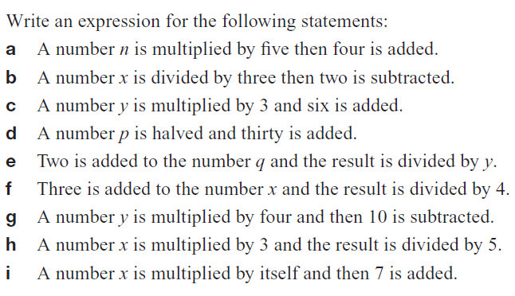
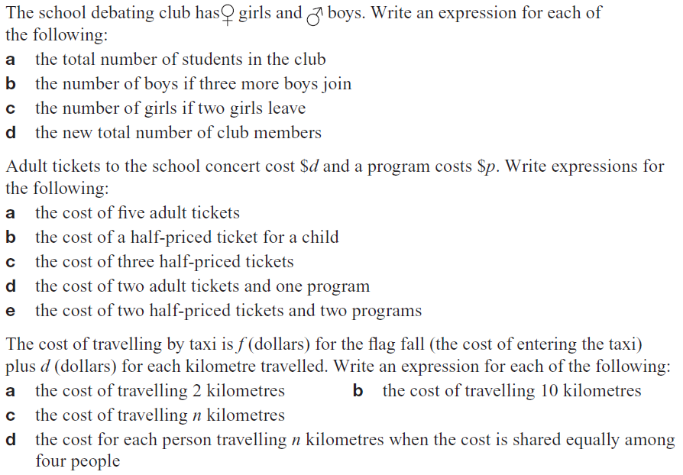
Task

Slide 7
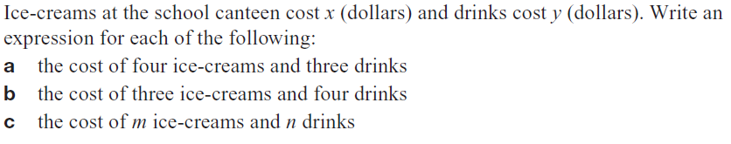
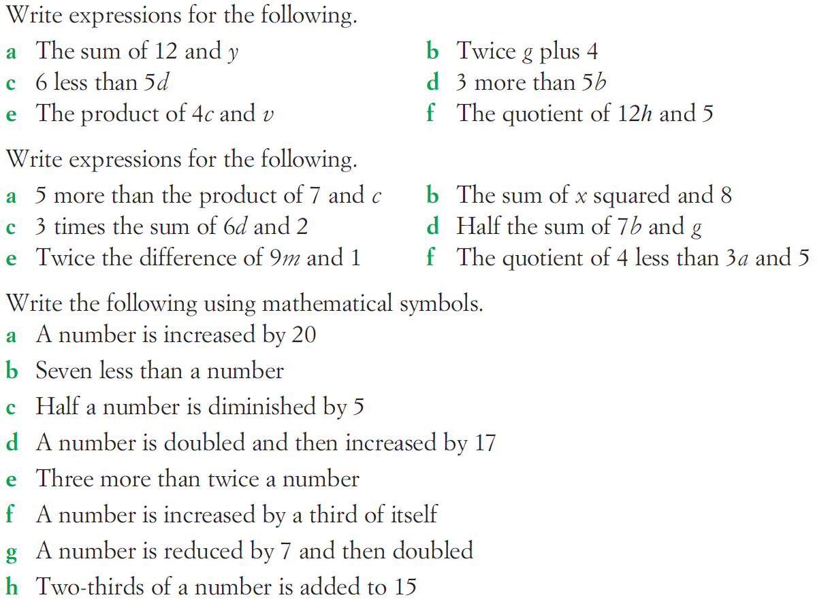
Task

Slide 8
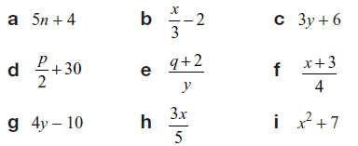
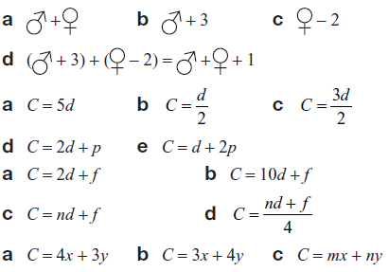
Answers

Slide 9
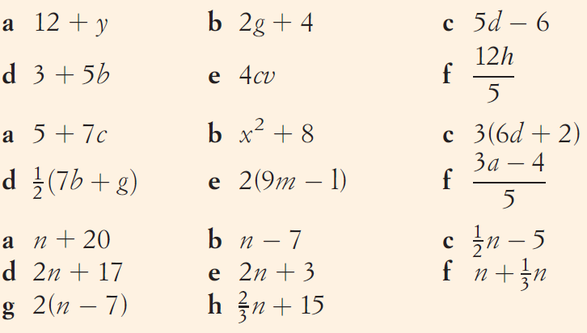
Answers

Slide 10
Notes Review
24, 7 ,30
Date
Title
Essential question
Notes complete
Notes complete with colour and diagrams
Questions completed
Contents page filed in
Formula page filled in

Slide 11
Homework
Review your notes and write a summary answering the essential question.

